Slide 1



Agentic AI

Slide 2
Agenda
Overview of Generative AI and Agentic AI
Overview of Large Language Models(LLM’s)
Use cases of LLM’s
Pre training and Fine tuning
Difference between NLP and LLM
Steps to build LLM’s
Transformers: The core of LLM’s, Architecture and Workflow
Overview and Architecture of GPT
BERT vs GPT
Stages of building LLM
Basic Tokenization code
Types of Tokenization algorithm
Byte pair encoding with code
Input target pairs with code
Token Embedding
Vayu Group Private and Confidential 2024

Slide 3
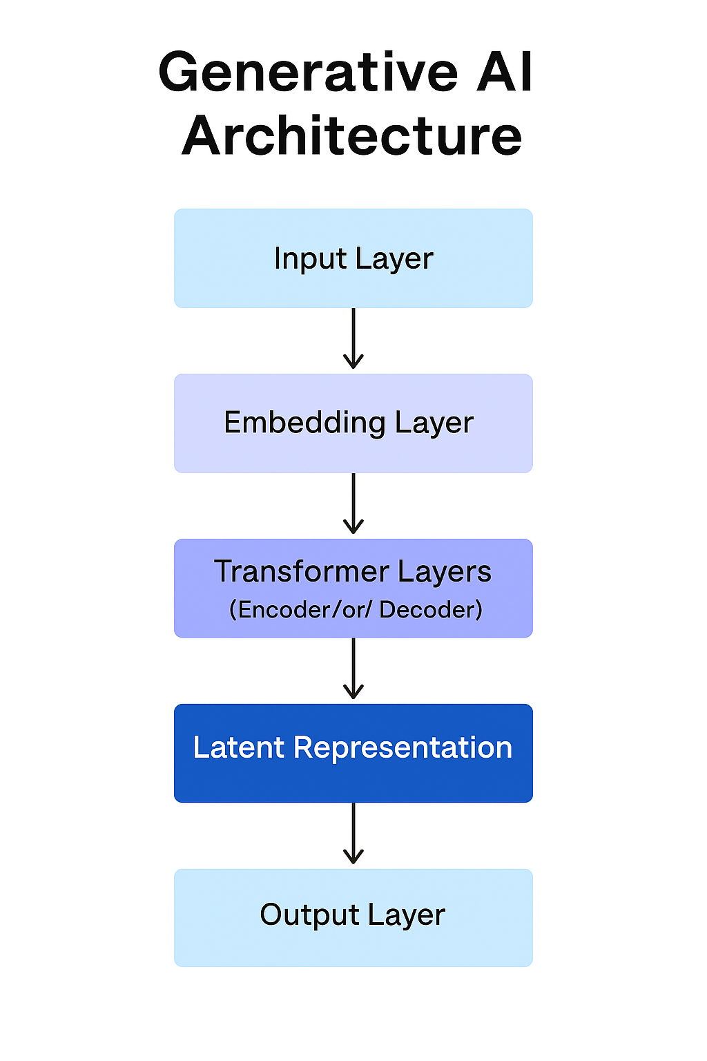
Generative AI
Generative AI is one of the type of artificial intelligence that works on creating new content rather than just analyzing or predicting from existing data. Compare to traditional AI, which classifies or detects patterns, Generative AI models are trained to produce original outputs such as text, images, music, video, or even computer code.
Features of Generative AI
Created new and original content
Learns from large data set
Works with text, audio, image.
Examples: ChatGPT, Gemini, Sora, GitHub Copilot…etc.,
Vayu Group Private and Confidential 2024

Slide 4
Generative AI
Working
Training: Learns from a massive dataset (Example: books, images, etc.)
Pattern Recognition: Understands how text, language, visuals, or sounds are structured
Generation: Creates new content based on a user input from the dataset
Pros of Generative AI
Boosts creativity and Innovation
Increases productivity
Personalization
Cons of Generative AI
Misinformation and Faking
Copy right issues
Lack of accuracy
Vayu Group Private and Confidential 2024

Slide 5
Agentic AI
Agentic AI is a new technology which doesn’t react only commands it acts like autonomous agent with goals, memory, decision-making, and planning abilities.
It can make decisions, take actions, and even learn on its own to achieve specific goals.
Applications of Agentic AI
Coding assistants
Health care
Customer support
E-Commerce
Vayu Group Private and Confidential 2024

Slide 6
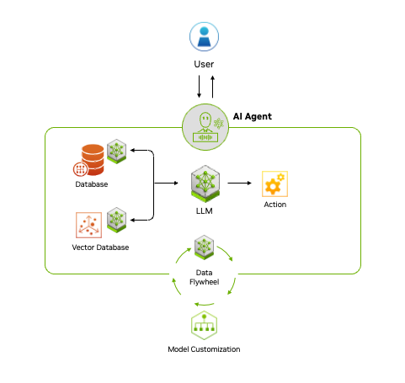
Agentic AI
Agentic AI operates in four key stages
Perception: It gathers data from various resources.
Reasoning: It processes this data to understand what’s going on.
Action: It decides what to do based on its understanding.
Learning: It improves and adapts over time, learning from feedback and experience
.
Vayu Group Private and Confidential 2024

Slide 7
Generative AI vs Agentic AI
.
Generative AI | Agentic AI
Generates content (text, images, code) | Executes multi-step tasks autonomously
Responds to single prompts | Plans, reasons, and acts proactively
Needs human input each time | Works independently after goal given
Examples: ChatGPT, DALL·E, GitHub Copilot | Examples: AutoGPT, Devin AI, BabyAGI, CrewAI
Creative writing, art generation, coding help | Workflow automation, research, software development
Sometimes uses external APIs | Actively integrates APIs, web tools, and memory
Vayu Group Private and Confidential 2024

Slide 8
LLM’s(Large Language Model’s)
LLMs are deep learning models trained on massive amounts of textual data. They can understand and generate human-like language and perform tasks like translation, summarization, question answering, and more.
Why it is called Large Language Model because its works with large data sets, architecture and computation.
It takes large data sets from the website like Wikipedia ,books et.., and models with billions of parameters and uses high CPU’s and GPU’s for computation.
Use cases:
GPT (Generative Pretrained Transformer)
BERT (Bidirectional Encoder Representations from Transformers)
LLaMA, PaLM, Claude, Gemini, etc.
Vayu Group Private and Confidential 2024

Slide 9
Pre-training and Fine-tuning
Pre-training and fine tuning are two stages in LLM’s
Pre-training – The Foundation
Pre-training is trained on large text corpora (books, web pages, articles).
The main objective is to predict next word or fill masked words.
It is self-supervised learning
It learns general patterns, syntax, grammar, reasoning and even word knowledge
Simply train a model on large dataset before tuning on a specific task, it doesn’t have enough labeled data.
Fine Tuning –Task specialization
Taking a pre trained model like BERT or GPT and train more on your specific task using labeled data
It uses small labeled data sets
Adapts model into different tasks like sentiment analysis, code generation with accuracy.

Slide 10
NLP vs LLM
NLP (Natural Language Processing) | LLM (Large Language Model)
NLP deals with understanding and processing human language | LLM under NLP that learns language patterns from large text.
It is rule based or classic ML | Based on neural network architecture
Works on tasks like translation, sentiment analysis, question answering, etc. | Great at writing text that makes sense and fits the situation — like chatting, writing code, or making summaries.
Can be small-scale and task-specific | Requires massive data and compute for training using deep learning.
Example: POS taggers, TF-IDF, Word2Vec | Example: GPT-4, BERT, LLaMA, Claude
.

Slide 11
Steps to build an LLM
Data Collection: Gather massive amounts of diverse text data from books, websites, and other public sources
Data Cleaning: Remove irrelevant, duplicate, or harmful content to ensure quality and safety.
Tokenization: Break down text into smaller parts (words) and convert them into numbers the model can understand.
Model Architecture Design: Choose the structure of the model, typically using the transformer architecture with layers and attention heads.
Pretraining: Train the model to predict or generate text using large-scale self-supervised learning on the collected data.
Fine-tuning :Adapt the pretrained model to specific tasks or domains by training it on targeted datasets.
Evaluation: Test the model's performance using metrics and tasks to ensure quality, accuracy, and safety.
Deployment: Integrate the model into applications (like chatbots or APIs) for real-world use.
Monitoring & Updates: Continuously track usage, fix issues, and improve the model with new data and techniques.
.

Slide 12
Transformers Architecture
Transformers Architecture was introduced in 2017 by Vaswani et al. in the paper “Attention Is All You Need.”
It is the core engine behind almost all modern LLMs including GPT, BERT, GEMINI etc.
Transformers allow LLMs to understand, process and generate language by modelling relationship between words in a flexible way.
Transformers generally process input text, Understand relationships, generate text, Supports multitasking.
Transformers learns all words at once (not one by one like older models).
It’s generally composed of: Encoder – Encodes input text into vectors Decoder- Generates output text from encoded vectors
Transformer not equal to LLM
.

Slide 13
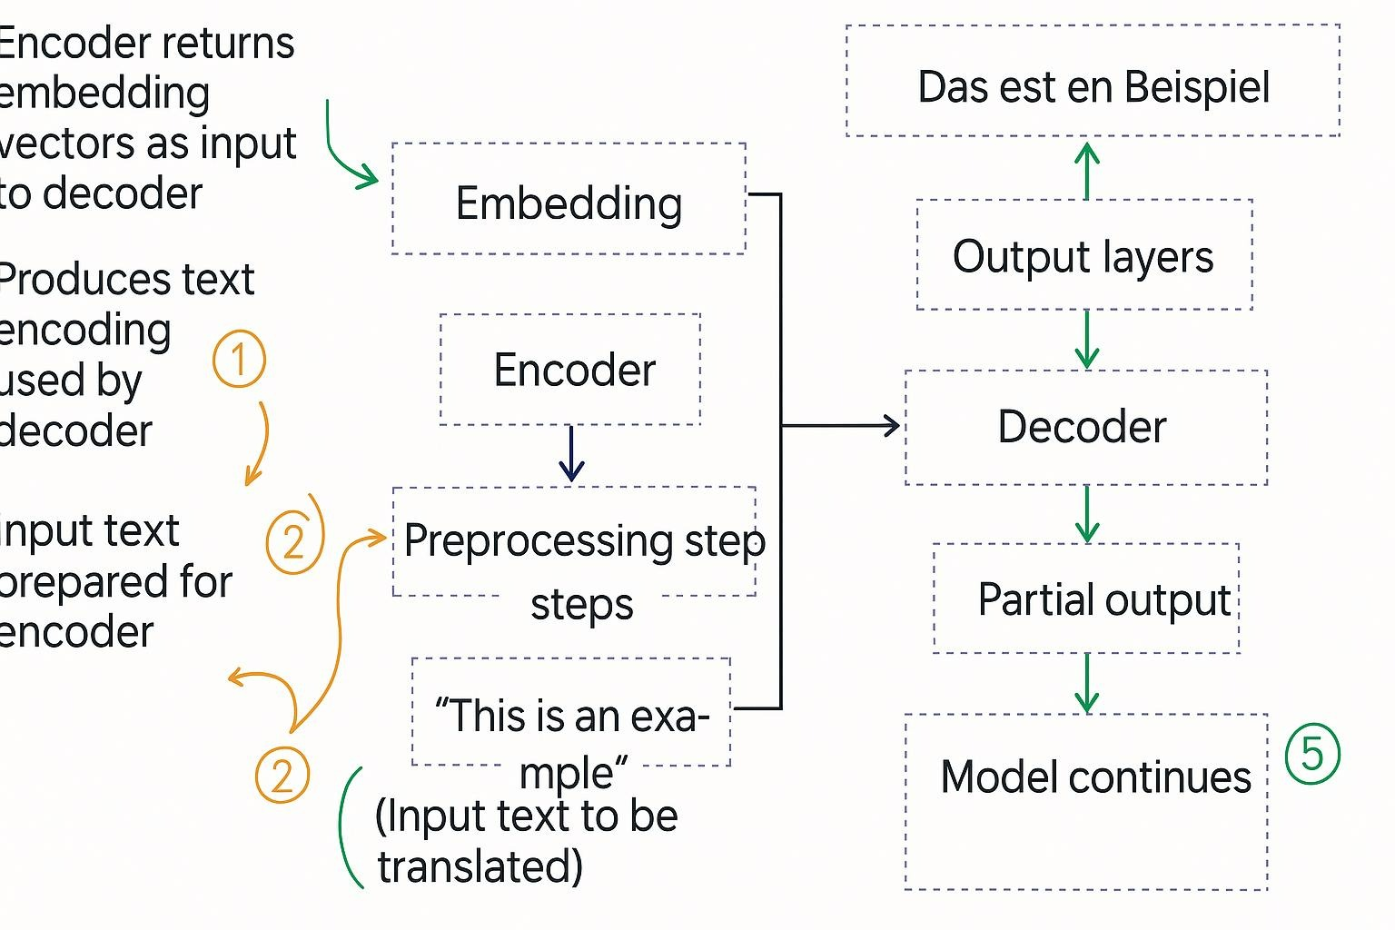
Transformers Workflow
Tokenize the input (Tokenization) : Breaks it into tokens like [for example: “write” , “a” , “poem”]
Vector Embedding : Assigning token id’s to token [Ex: “write” : 0, “a” : 1, “poem” : 2]
Encoder : Processes the input text
Decoder: Processes the output text from encoded vector.
Self-Attention Mechanism: Focus on important words in a sentence by assigning “attention scores”.
Output layer: Generates the final result word by word, it predicts the next word based on input and past output.
.

Slide 14
Overview of GPT
GPT(Generative Pretrained Transformer) is a type of Transformer model that generates text by predicting one word at a time, from left to right.
GPT doesn’t have encoder only performs the task on decoder.
GPT model are trained on “next word” prediction task.
Original transformers has 6 encode and decoder block and GPT-3 has 96 transformers and 175 billion parameters.
GPT is called as “emergent behavior” (it means model has ability to perform many different things like language translation , next word prediction etc.,.)
.

Slide 15
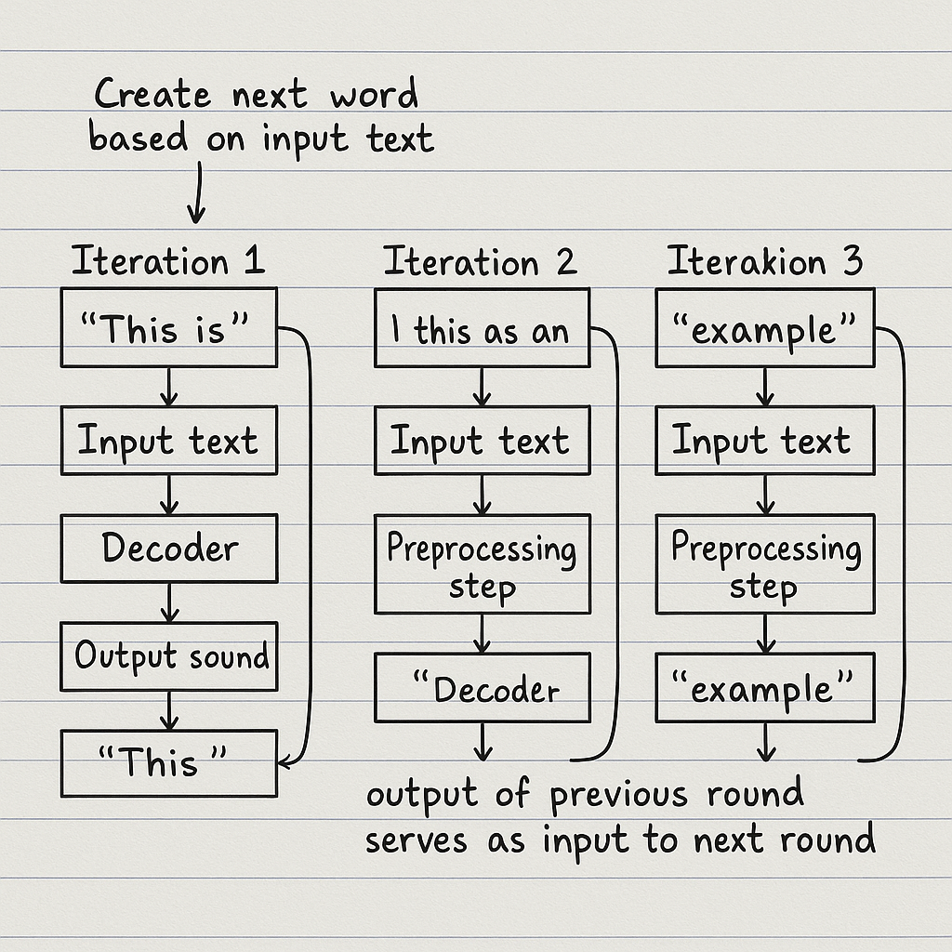
Architecture of GPT
.

Slide 16
BERT and GPT
BERT | GPT
Bidirectional Encoder Representations from Transformers | Generative Pre-trained Transformer
Encoder-only Transformer | Decoder-only Transformer
Masked Language Modeling + Next Sentence Prediction | Autoregressive Language Modeling
Bidirectional context (left & right) | Unidirectional context (left to right)
Best for understanding tasks (QA, sentiment, classification) | Best for text generation, completion, summarization
Examples: BERT-base, BERT-large | Examples: GPT-2, GPT-3, GPT-4
.

Slide 17
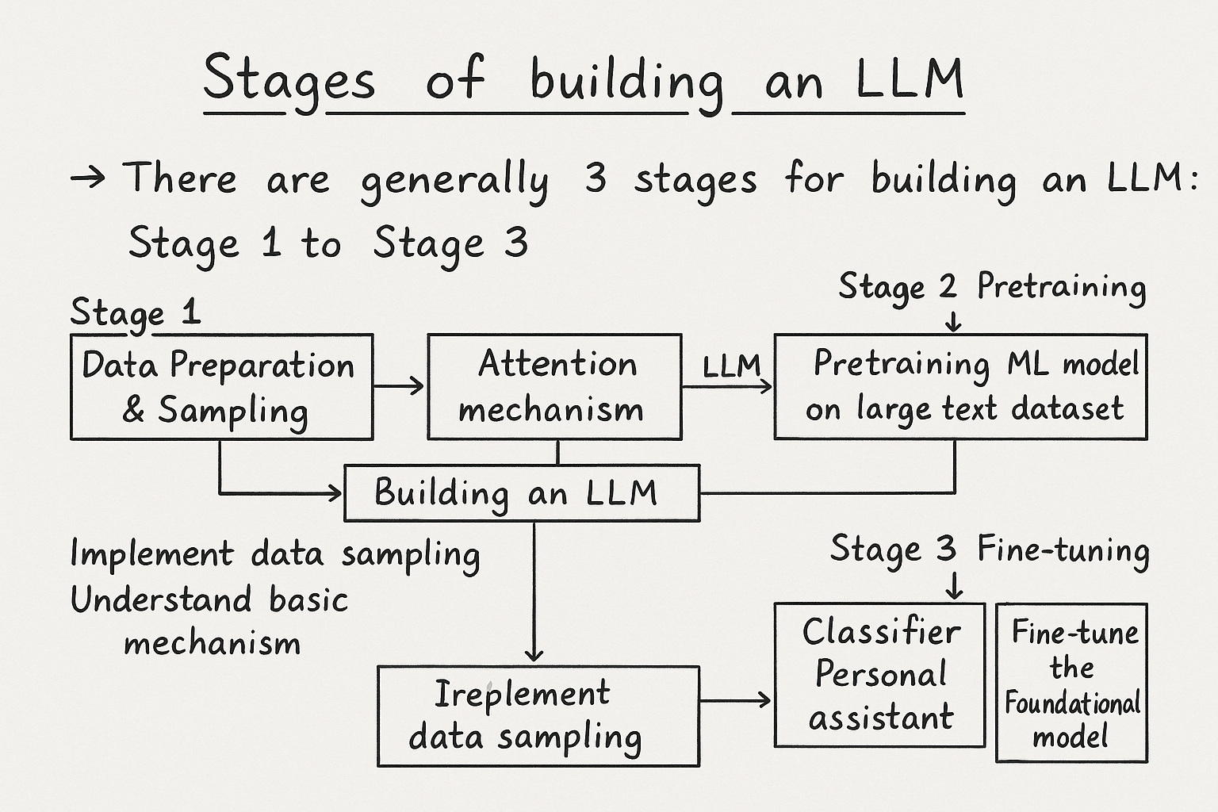
Stages of building LLM
There are three stages of building an LLM
Stage 1: Data preparation and sampling
Stage 2: Pre-training
Stage 3: Fine-tuning

Slide 18
Stage-1 : Data preparation and sampling (Tokenization)
Tokenization: Breaking down text into smaller chunks called tokens and this process is called Tokenization and there are three stages Step 1 : Splitting text into individual tokens. Step 2 : convert token into token Id’s. Step 3 : Encode token id’s into vector representation.

Slide 19
Tokenization code
import re
# Sample text
text = "hi how are you"
unknown_text = "hi where are you now"
# Step 1: Tokenize the text using regex
def tokenize(text):
tokens = re.split(r'([,.:;?_!"()\']|--|\s)', text)
return [t.strip() for t in tokens if t.strip()]
tokens = tokenize(text)
print("Tokens:", tokens)
# Step 2: Create a vocabulary
vocab = {token: idx for idx, token in enumerate(sorted(set(tokens)))}
print("Vocabulary:", vocab)

Slide 20
# Step 3: Define tokenizer class
class SimpleTokenizer:
def __init__(self, vocab):
self.vocab = vocab
self.rev_vocab = {v: k for k, v in vocab.items()}
def encode(self, text):
tokens = tokenize(text)
return [self.vocab.get(t, -1) for t in tokens] # -1 for unknowns
def decode(self, ids):
tokens = [self.rev_vocab.get(i, "<UNK>") for i in ids]
return " ".join(tokens)
# Step 4: Try encoding and decoding
tokenizer = SimpleTokenizer(vocab)
encoded = tokenizer.encode(text)
decoded = tokenizer.decode(encoded)
encoded_unknown = tokenizer.encode(unknown_text)
decoded_unknown = tokenizer.decode(encoded_unknown)
print("Encoded:", encoded)
print("Decoded:", decoded)
print("\nUnknown Text Input:")
print("Encoded:", encoded_unknown)
print("Decoded:", decoded_unknown)

Slide 21
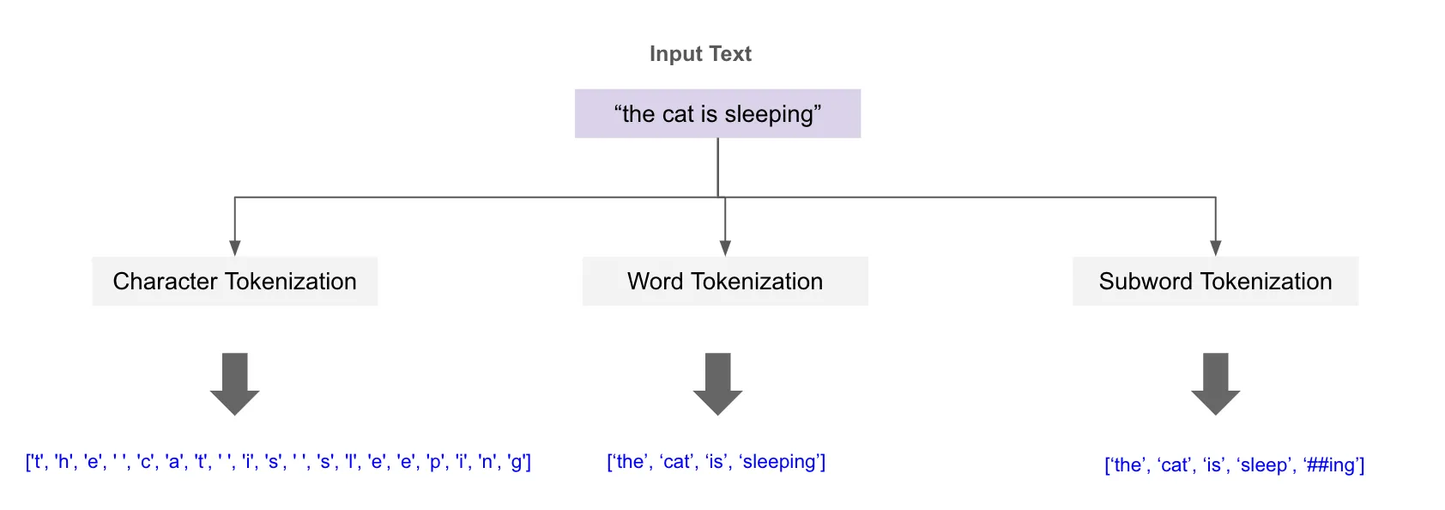
Tokenization Algorithm
Word-based tokenization: Splits text into individual words as tokens (e.g., "I love AI" → ["I", "love", "AI"]).
Subword-based tokenization: Splits words into smaller meaningful parts or subwords (e.g., "unhappiness" → ["un", "happi", "ness"]).
Character-based tokenization: Splits text into individual characters (e.g., "AI" → ["A", "I"]).

Slide 22
Byte Pair Encoding
Encoding: Encoding is the process of converting data—such as text, images, audio, or other inputs—into a numerical or symbolic format that a machine learning model can understand and process.
Byte pair encoding: It is a sub word tokenization algorithm it breaks words into smaller more frequent chunks (called sub words) to help language models.
It is used for LLM like GPT process text as a token not words.
Why BPE used in LLM:
It helps reduce the size of the vocabulary.
It can handle rare and unknown words by breaking them into known sub-parts.
It balances between character-level and word-level tokenization.

Slide 23
Steps for Byte Pair Encoding
Prepare the Dataset: Start with a list of words or tokens along with their frequencies from a given text corpus. This provides the initial vocabulary
Add End-of-Word Marker: Append a special end-of-word token (like </w>) to each word. This helps preserve word boundaries and avoid incorrect merges between words.
Initialize Vocabulary: Split each word into its individual characters (including the end token). Each character becomes a symbol in the initial vocabulary.
Count Symbol Pairs: Scan the entire dataset and count the frequency of each adjacent pair of symbols. These pairs can be any two neighboring characters or subwords.
Find and merge Most Frequent Pair: Identify the symbol pair that appears most frequently across all words in the dataset and replace all instances of the most frequent pair with a new symbol formed by merging the two. This new symbol is added to the vocabulary.
Update the Dataset: Modify the dataset by replacing occurrences of the merged pair with the new symbol. This reduces the number of total tokens over time.
Repeat the Process: Repeat steps 4–7: count pairs, merge the most frequent, and update the dataset. Continue this until a predefined vocabulary size is reached or no more useful merges are possible.
Final Vocabulary :Once finished, the vocabulary consists of frequently occurring subword units. These subwords can now be used to tokenize new words, including unknown ones, by breaking them into the closest matching subword units.

Slide 24
Byte Pair Encoding implementation
import tiktoken
# Load GPT-2's BPE tokenizer
tokenizer = tiktoken.get_encoding("gpt2")
# Encode text
text = "Hello! Do you like tea?<|endoftext|>In the sunlight terraces of someunknownplace."
token_ids = tokenizer.encode(text)
print("Token IDs:", token_ids)
# Decode back to text
decoded_text = tokenizer.decode(token_ids)
print("Decoded Text:", decoded_text)

Slide 25
Creating input target pairs for LLM
Input target pairs: In machine learning, we usually have
Input (X): The data given to the model (e.g., an image of a cat).
Target (Y): The expected output (e.g., the label "cat").
For Large Language Models (LLMs), the task is next-word prediction.
Input: A sequence of words (e.g., "The cat sat on the").
Target: The next word (e.g., "mat").
Why input target pairs:
Training LLMs: Models like GPT learn by predicting the next word in a sequence
Context Matters: A fixed context size (e.g., 4 words) helps the model understand patterns.
Efficiency: Breaking text into smaller chunks avoids memory overload.

Slide 26
Code for input target pairs for LLM
import tiktoken # Library for tokenization using OpenAI's encoding schemes
import torch
from torch.utils.data import DataLoader, Dataset
# Define a custom PyTorch Dataset class for tokenizing text
class token(Dataset):
def __init__(self, txt, max_length=3, stride=1):
self.in_l = [] # List to hold input token sequences
self.tar_l = [] # List to hold target token sequences (next tokens)
k = tiktoken.get_encoding("gpt2") # Get GPT-2 encoding
l = k.encode(txt) # Encode the input text into token IDs
print(l) # Print encoded token IDs for reference
# Create sliding windows of input-target pairs
for i in range(0, len(l) - max_length, stride):
q = l[i:i + max_length] # Input sequence of length max_length
p = l[i + 1:i + max_length + 1] # Target sequence (next tokens)
self.in_l.append(torch.tensor(q)) # Convert input to tensor and store
self.tar_l.append(torch.tensor(p)) # Convert target to tensor and store

Slide 27
Code for input target pairs for LLM
def __len__(self):
# Return number of input-target pairs
return len(self.tar_l)
def __getitem__(self, idx):
# Return input and target pair at a specific index
return self.in_l[idx], self.tar_l[idx]
# Wrapper function to create a DataLoader from text
def dataloader(txt, batch_size=2, max_length=3, stride=1, shuffle=False, drop_last=False, num_workers=0):
tk = token(txt, max_length=max_length, stride=stride) # Create dataset object
dataloader = DataLoader(
tk,
batch_size=batch_size,
shuffle=shuffle, # Whether to shuffle data
drop_last=drop_last, # Drop last batch if it's smaller than batch_size
num_workers=num_workers # Number of subprocesses to use for data loading
)
return dataloader

Slide 28
Code for input target pairs for LLM
# Prompt user to enter input text
txt = input("Enter the text: ")
# Create a DataLoader from the input text
data = dataloader(
txt,
batch_size=2,
max_length=3,
stride=1,
shuffle=False,
drop_last=False,
num_workers=0
)
# Iterate through the DataLoader and print input-target pairs
for batch_size, (in_l, tar_l) in enumerate(data):
print(batch_size + 1) # Print batch number
print(in_l) # Print input sequences in the batch
print(tar_l) # Print target sequences in the batch

Slide 29
Token Embedding
Embeddings turn words into numbers that a computer can understand.
Similar words have similar numbers, so the model can learn meaning.
Each word is represented as a fixed-size vector, like a list of 300 numbers .
Neural networks need embeddings to work with text.
Embeddings can be learned during training or taken from already trained models like Word2Vec or BERT.
They help the model understand relationships like “king” and “queen” are related.
They are used in many tasks, like chatbots, translation, and question answering.
Contextual embeddings (like BERT) understand word meaning based on the sentence.

Slide 30
THANK YOU

